Slide 1

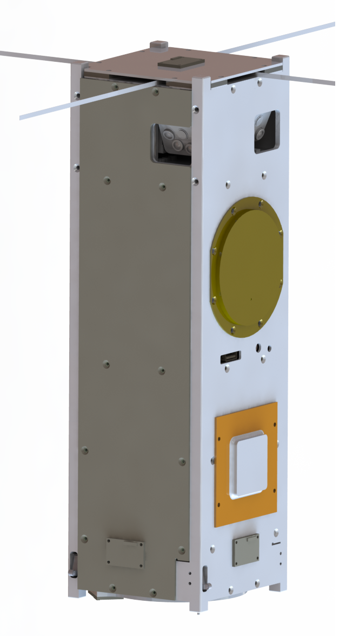

Phoenix
A 3U CubeSat to Study Urban Heat Islands
Sarah Rogers - Project Manager
NASA Space Grant Symposium
April 14, 2018

Slide 2



Phoenix Overview
Undergraduate-led 3U CubeSat to study Urban Heat Islands through infrared imaging
Student Flight Research Opportunity funded through the NASA USIP program and NASA Space Grant
Program start: April 2016
First fully undergraduate student-led effort to build a CubeSat at ASU
Mission Objectives
Phoenix is an educational mission, where our primary goal is to develop a functioning CubeSat, capable of imaging the Earth in the IR
Phoenix will study how city composition, using Local Climate Zones, affects the surface urban heat island signature in various U.S. cities
Projected launch date: Nov. 8 2018
Target Delivery Date: September 3, 2018
Launch integrator: Nanoracks
Launch facility: Wallops, VA
Launched from the ISS - orbit: 400 km altitude, 51.6° inclination
Operational timeline: 2 years
Currently in CDR phase
Focus is centered on software development & component level testing

Slide 3
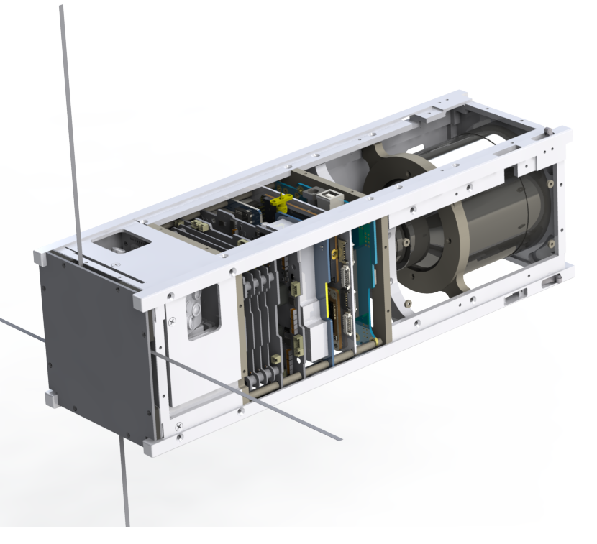
OBC, UHF Transceiver (top)
Nanodock Motherboard
GPS Receiver (bottom)
Satellite Overview
Payload, Tau 2 640 IR Camera:
Pixel Resolution: 640 x 512 (Pixel size: 17μm)
Image Resolution: 68 m/pixel (best), 110 m/pixel (worst)
Field of View: 6.2° x 5° (43.5 x 35 km ground footprint)
Thermal Resolution: < 50mK
Spectral Band: 7.5μm-13.5μm (non filtered)
Attitude Control:
Attitude Control: (3) Reaction Wheels, (3) Magnetorquers
Position Monitoring: Sun Sensors, IR Earth Limb Sensors
Pointing Accuracy: 0.5° (during imaging)
Communications:
Science Downlink: S Amateur Bands (2402.5 MHz)
Command Uplink: UHF Amateur Bands (437.35 MHz)
Clock & Position Monitoring: OEM615 GPS Receiver
Power
40 Whr Battery
EPS for power distribution
Cabling & Data Interfaces
Interface board used for cable routing and data storage
EPS
FLIR Camera
ADCS
Interface Board
S-Band Transmitter
UHF antenna
40Whr Battery
Notes:
Go over what’s in the satellite, how its used, strongly encourage interface board

Slide 4
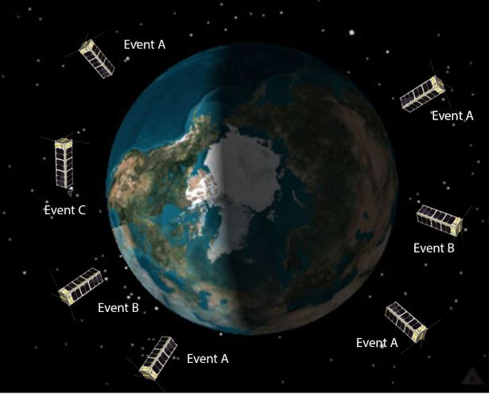
Concept of Operations
Event A: Idle Mode
Housekeeping data collection, health beacons, UHF command uplink
Duration: Default mode
Orientation: on-Nadir pointing, sun favoring
Event B: Science Mode
Images are taken of target US cities
Duration: 15 min (max)
Nadir pointing, sun favoring
Event C: S-Band Transmission Mode
Occurs 3x/week, only during the day (need sun sensors)
Duration: 5 min (typ)
Satellite is parallel to the earth, sun favoring with tracking to the ASU ground station
Event D: Safe Mode
Lowest amount of power is consumed - only components required for survival are on until otherwise commanded by mission operators
Orientation: Nadir
Daylight
Event D
Eclipse
‹#›
Notes:
Top level overview of the conops. Just state the modes and what we do in them

Slide 5
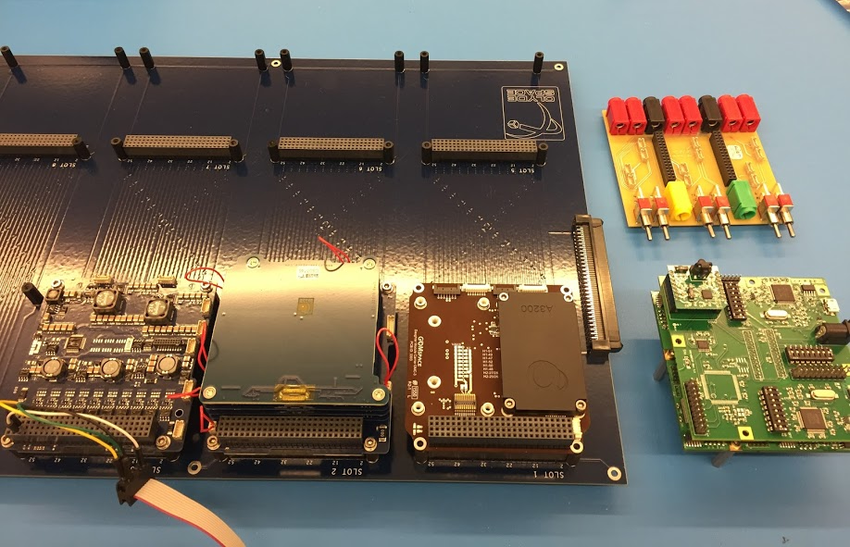
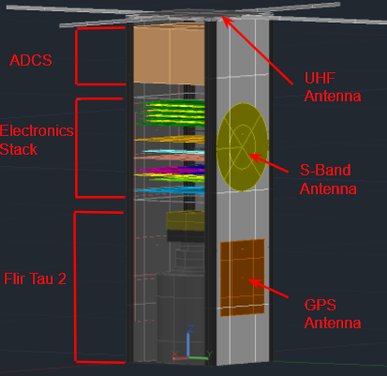
How we Break Down
ADCS
Gain tuning & verification
Pointing accuracy & stability analyses
Comms
Integrates ground station/satellite hardware - verifies link budget
EPS
Power budget & EPS management
Interface board
Mission Ops
Schedule planning (NAIF & JMars)
Telemetry management (COSMOS)
Payload
Determines how the payload operates and how it affects the science objective
Software
software/hardware integration
Structures
Develops satellite chassis & mounting brackets
Systems/Management
Schedule, project management, environmental testing
Fills in the gaps
Thermal
Thermal modeling in thermal desktop
Model verification
Notes:
All mission planning is fine and dandy, but how exactly do you get to launch readiness? How do you develop a cubesat to be completely functional, and how do you do this when you have no prior experience with what you’re doing? Every cubesat is different. We struggled for a long time to really define exactly what it was we needed to do, and now we’ve got a handle on it. Here’s the breakdown
ADCS
Gain tuning is important- the vendor won’t do it for a cheap price, and it is doable to do as an undergrad, if you have the right resources
Pointing accuracy - remote sensing mission - must prove that we can hit our targets each time and if not, we know how to correct it
Comms - know the cubesat hardware and GS resources - responsible for integrating these toegether/making the link work
Knowing your resources is key - mention the ones that people may not know about
Mission ops: NAIF (orbit propagation), COSMOS (telemetry parsing)
Thermal desktop - free resource
Power generation analysis - STK

Slide 6
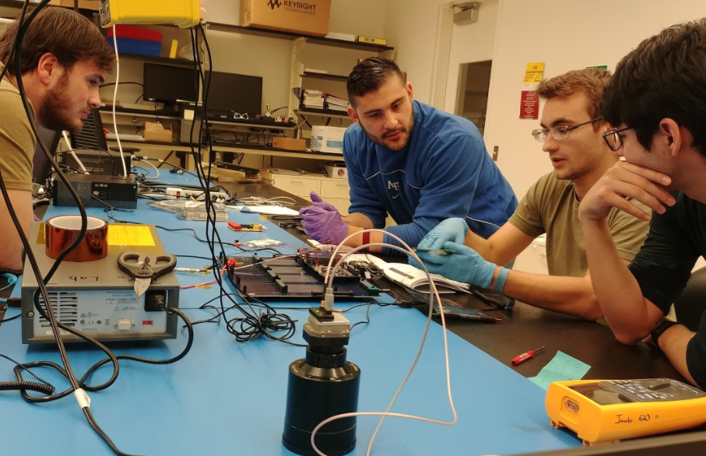
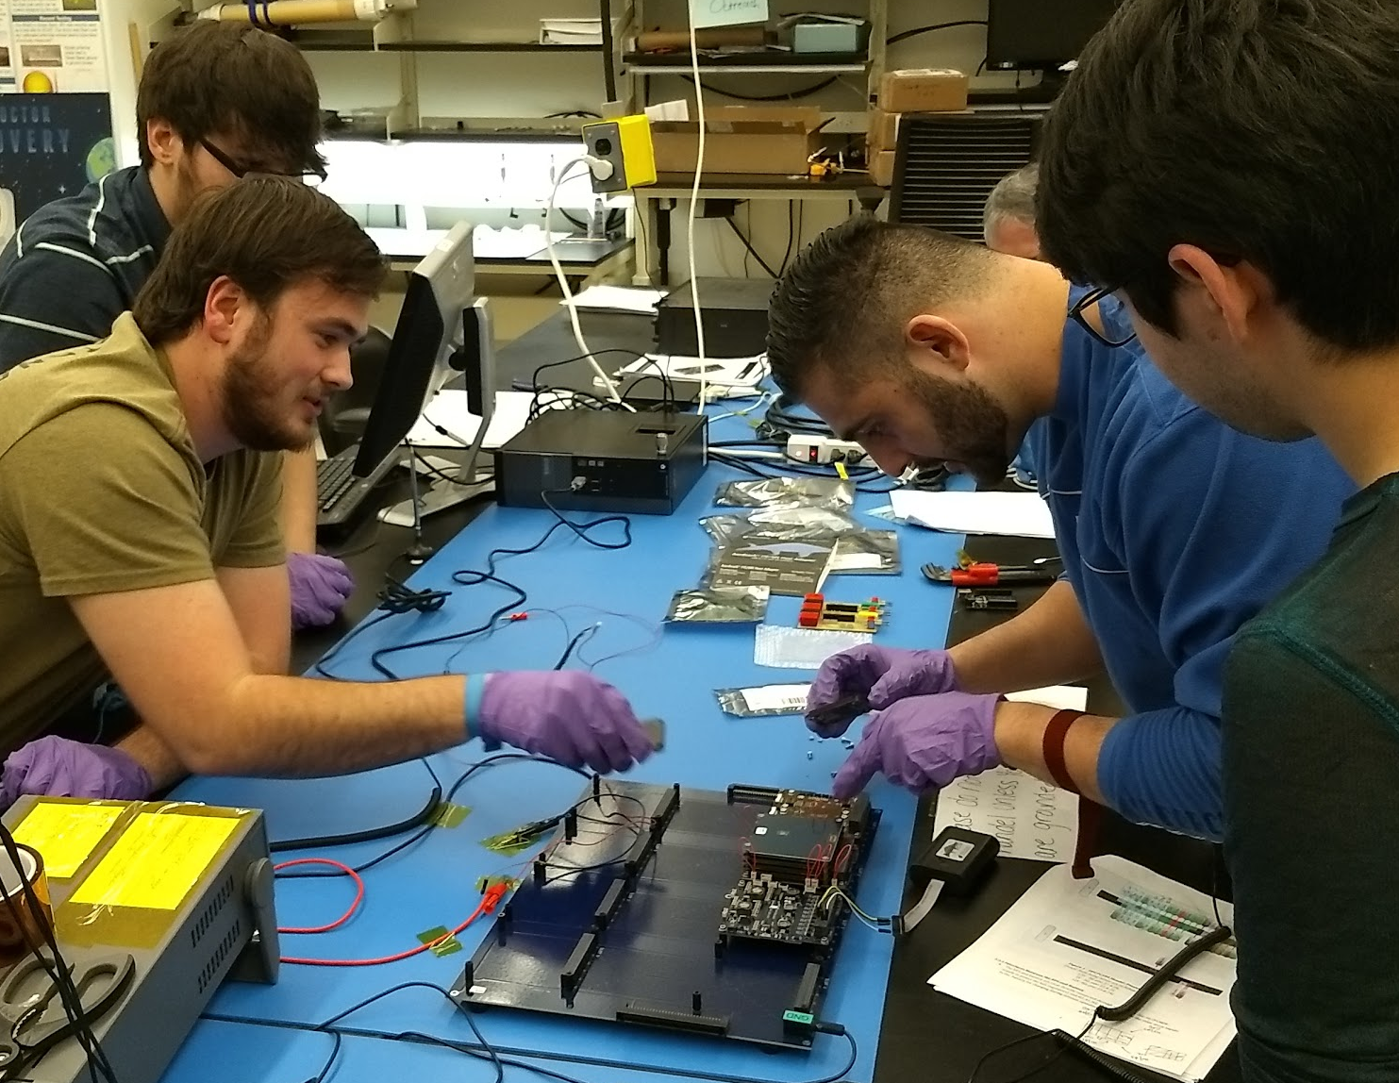
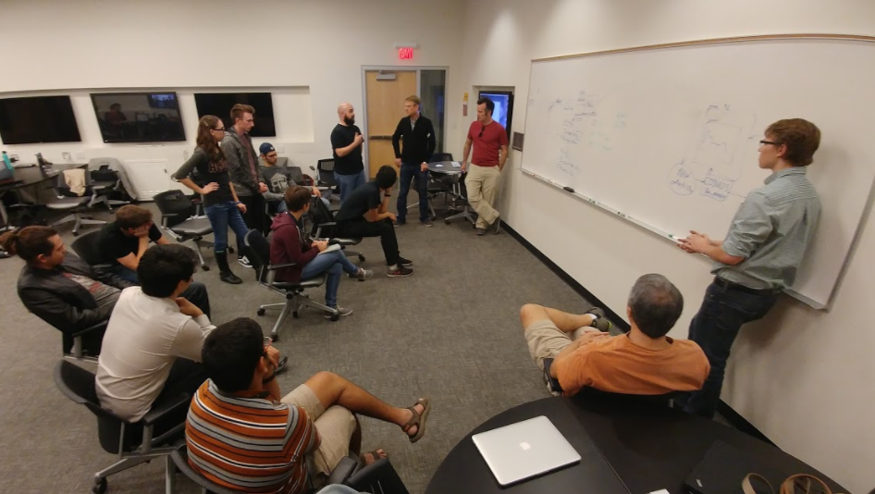
How Do You Get to Launch Readiness?
Define: What are your minimum functionality requirements, and how do you complete those?
For Phoenix: We will have a CubeSat which can point, take a picture of the earth, and downlink it
Organize minimum, ideal, and “nice to haves”
Then, build up from the base requirements
Flow your tests from your requirements
Prioritize, prioritize, prioritize
Notes:
Much of what was said on the previous slide is broad. - how does all of that break down to allow us to create a functional cubesat? Where do you start with putting subsystems together and seeing your satellite become a fully functional unit?
Define your minimum functionality - there’s a lot you need to do, but what is the bare minimum you need for success? - for us, it’s point, image, downlink.
We had one software integrator - so we need prioritize further - first get the camera integrated on the OBC, then build up from there.add the EPS, now downlink that image
Work as much in parallel as you can
Most importantly, keep everyone focused on the common goal
Decisions need to be made quickly, so set go/no go dates for major decisions

Slide 7
Lessons Learned from Development
Setting a Schedule
Outline your larger milestones first & work backward, flow these from your requirements
Define weekly deliverables which add to the milestone
Working Toward a Goal
Task tracking & progress must be transparent to everyone
Define hard, clear deliverables
Integrating Everything Together
Start prototyping as early as possible, stay on top of your resources
Consider: is it more efficient to learn by doing?
Focus on piecewise software/hardware integration
Know and organize your resources
Notes:
Partitionable tasks
Overall, your schedule will not work unless you have everyone on board - the schedule must be a group effort
Make the schedule easy to access - all of our resources are on the google drive ‘
Your schedule is always moving - you need to keep up with it, and so does your team. Do weekly reviews of the schedule and make sure everyone is on task. Everyone must know how they fit into the common goal, or your goal won’t be met
Prototype early
One issue we had that put us back in our timeline was that we didn’t get resources early enough. Hardware came in late, so all we could do was work on the theoretical stuff. Planning how to code for hardware is much different than actually sitting down and trying to make it work
If you can, get an exact replica of your hardware, butif you can only get one engineering unit, at least make it the OBC, and do all your development with the hardware you plan to use
Learn by doing
Caution is very good to have. You never want to jump right into testing hardwre you are uncomfortable with. But sometimes this isn’t always the best approach. Being cautious and trying to plan out every step is not always as efficient. You waste time preparing very detailed, documented test plans, before testing is even done. For testing, consider if it is worth it to plan things carefully, or if you would make more progress by going into the lab and testing out the commands (planning is important for batteries, not for radios)
Piecewise
It’s important that your software is written, but what is more important is the integration side of hardware/software. This should be done in parallel with application development, where you have the people who are working on the hardware applications and one person who is working on putting software on the OBC and making it work as you expect it to

Slide 8
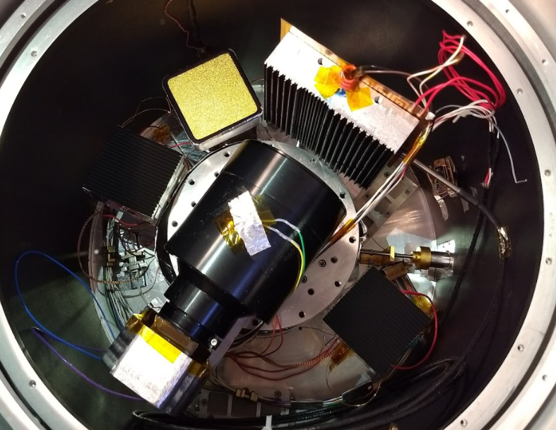
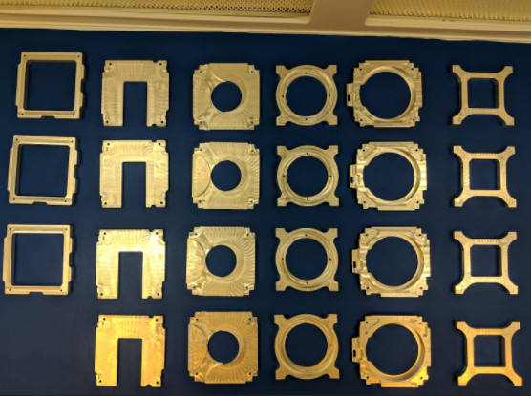
Acknowledgements
Industry Partners
NASA Wallops/Goddard (USIP)
Jack Lightholder (JPL)
Belinda Shreckengost (JPL)
Travis Imken (JPL)
Conor Brown, Henry Martin, Tristan Prejean, Nathan Daniels (Nanoracks Integration Team)
Brackett Aircraft Company
EagleSat II Team (ERAU)
ASU Affiliate
ASU NASA Space Grant - special thanks to Dr. Tom Sharp & Desiree Crawl!
Dr. Judd Bowman
Dr. Daniel Jacobs
Dr. Paul Scowen
Ernest Cisneros
Dr. Mark Miner
Andrew Ryan
Those above have helped the team with what has been an amazing journey, and we could not be more grateful

